Slide 1

Safety and Secured Two Wheeler

Slide 2
Project Architecture
Thermal Management
Voltage & Current controlled I/O
Electrical Control
HMI User Interface
ADAS
Battery Management
Data Acquisition
Pothole Detection
Cruise Control
Efficient Memory backup
Cloud / Dashboard Statistics Analysis
GEO Tagging & Tracking
Bluetooth enabled user interaction
Encrypted DB

Slide 3
Modes- Eco & Sport
Smoke Sensor
Stand and Indicator LED
Temp Sensor
Ignition Switch
Ignition &Driving ECU 1
BMS ECU 2
Warning LED
Cruise Input
Voltage/Current Sensor
CAN I/O
CAN I/O
CAN I/O
CAN I/O
ESP 8266
WiFi Module
Instrument Cluster ECU 3
LCD
Black Box ECU 4
Bluetooth
Buzzer
LiDar & Ultrasonic
Hall Sensor
GPS
EEPROM

Slide 4
Project Description
This project is to develop an application for an electric scooter with safety and security.
This application consists of combined four different applications like Ignition & cruise control, Black box , BMS and Instrument cluster
It includes Safety and security with efficient power backup.

Slide 5
Design Constraints
Commercial Constraints Basic commercial constraints such as time and budget.
Requirements Functional requirements such as specifications of features for a product.
Non-Functional requirements Requirements that specify intangible elements of a design. For example, non-functional requirements that a building be accessible.

Slide 6
Design Constraints
Compliance Compliance to applicable laws, regulations and standards.
Style A style guide or multiple style guides related to an organization, brand, product, service, environment or project. For example, a product development team may follow a style guide for a brand family that constrains the colors and layout of package designs.
Sensory Design Beyond visual design, constraints may apply to taste, touch, sound and smell. For example, a brand identity that calls for products to smell fruity.

Slide 7
Design Constraints
Usability Usability principles, frameworks and standards. For example, the principle of least as very great surprise.
Principles The design principles of an organization, team or individual. For example, a designer who uses form follows function to constrain designs.
Integration A design that needs to work with other things such as products, services, systems, processes, controls, partners and information.

Slide 8
ES Design Contstraints
Cost
Size and Weight
Power & Energy Limits
Environment
Temperature range of voltage requirement(Low Voltage)
Microcontroller or Microprocessor
With Processor and general Microcontroller
Programming Language
Embedded C or Linux
OS
No OS or RTOS, interrupt, barebold
Runtime testing, boot loading time, initial time consumption
Integrity Constraint

Slide 9
Software Quality
What is software quality?
The quality of software can be defined as the ability of the software to function as per user requirement. When it comes to software products it must satisfy all the functionalities written down in the SRS document.

Slide 10
Software Quality
Software Quality:
Software quality is the characteristic of the software that defines how well the software meets the customer requirements, business requirements, coding standards etc. It can be divided into two categories:
Software Functional Quality: characteristics that define how well the software meets functional requirements, and how well it satisfies the end-users.
Software Non-Functional Quality: characteristics that define how well structural requirements are met that support the delivery of functional requirements. It is usually related to software code and internal structure.

Slide 11
Key aspects-software quality
Good design – It’s always important to have a good and aesthetic design to please users
Reliability – Be it any software it should be able to perform the functionality impeccably without issues
Durability- Durability is a confusing term, In this context, durability means the ability of the software to work without any issue for a long period of time.
Consistency – Software should be able to perform consistently over platform and devices
Maintainability – Bugs associated with any software should be able to capture and fix quickly and news tasks and enhancement must be added without any trouble
Value for money – customer and companies who make this app should feel that the money spent on this app has not fone to waste.

Slide 12
Key aspects-software quality
Testability – How easy it is to test the software and to what extent it can be tested.
Usability – It defines how user friendly the software is.
Understandability – How easily the software can be made understood to a layman about its functions/purpose
Efficiency – It defines the amount of work that the software can do in defined timeframe with minimum resources used.
Effectiveness – The extent to which the software satisfies the user and meets user requirements
Accuracy – How accurately the software works with gives the correct results.

Slide 13
Key aspects-software quality
Security – How secured the software is in terms of access authorization and personal data like passwords.
Robustness – How robust the software is under unexpected events like software crash, power-off etc and saves its data.
Portability – How easily the software can be transported and run in different environments e.g. platforms like operating systems (Linux, Mac, Windows), machines it can run on.

Slide 14
Microcontroller Memory mgmt
Flash memory:
Remembers data after power is turned off.
Slow read/write speeds compared to RAM/ROM
Can be manufactured in higher storage capacity than RAM/ROM
Used for SSDs, USB drives
RAM (Random Access Memory)
Loses data when powered off.
Fast read/write speeds
Relatively expensive to manufacture
Used for storing program memory while computer is running

Slide 15
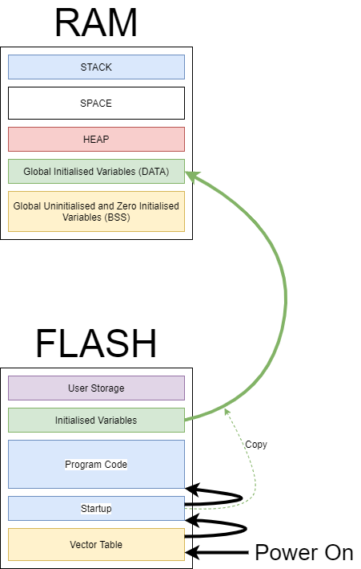

Slide 16
Memory Occupation in flash memory
Void main
{
Int a=10;
Int led=0x00;
Switch(a)
{
Case 10:
led=0x01;
break;
Case 11:
led=0x02;
break;
Case 12:
led=0x03;
break;
Default:
break;
}
}
Void main
{
Int a=10;
Int led=0x00;
If(a==10)
led=0x01;
If(a==11)
led=0x02;
If(a==12)
led=0x03;
}

Slide 17
Memory occupation in RAM memory
Variable Declaration
Try to use pointers as much as possible
Less variable declaration
Define proper datatypes with length
Structures, unions and others
Avoid global variables as much as possible
Avoid breaks, continue.

